Slide 1

Urban Child Symposium Educating Children Living in Poverty: Identifying Obstacles - Planning for Success April 7, 2016 Karen Webber, Director Education and Youth Development

Slide 2

Race/Ethnicity and Percentage of Students Living in Poverty
SY 2015/2016 Student Enrollment: 84,730 total
Schools and Programs: 188 total

Slide 3
Urban Poverty: Exposure and Effects
Effects on Behavior
Urban Poverty - Exposure
Trauma/Chronic stress
Violence, neglect, abuse, drug addiction
Lead paint, other toxins
Family mobility - homelessness
Poor health/nutrition
Attention Deficit
Impulsivity
Anxiety
Depression
Impulse Control
Aggression

Slide 4
Racial Threat
What is it?
What does if look like?
Direct correlation between racial composition and discipline utilized
Majority Black Schools = Harsh Discipline
Armed Police
Metal Detectors
Zero tolerance
Expulsion
Suspension
Detention
Explanation for intensified punitive and social control when there is a concentration of African Americans. Based on perceived social, economic, criminal or other threat. Payne and Welch

Slide 5
School Discipline Reform
Progressive Policies Issued
Overly Broad/Harsh Sanctions Removed
Baltimore City Code of Conduct
Maryland State Discipline Policy
US DOE and DOJ Discipline and School Climate Guidelines
Reduction of “zero tolerance”
Maximum suspension “sentences” reduced
School Climate highlighted
Alternatives to suspension encouraged

Slide 6
Implementing Policy - School Climate
Proven Benefits:
Student Achievement
Graduation
Suspension Reduction
Increased Attendance
Overall sense of belonging and wellbeing
Strong Leader
Safety
Engaging Classrooms
Welcoming Environment
Positive Relationships

Slide 7
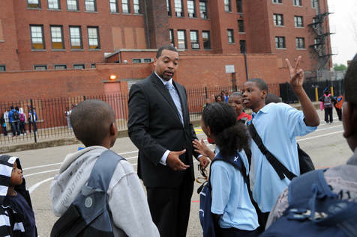
Leadership
Vision which includes happiness and success
Modeling the behavior expected
Constant messaging

Slide 8
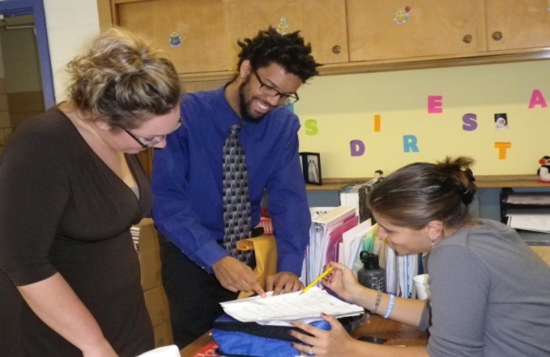
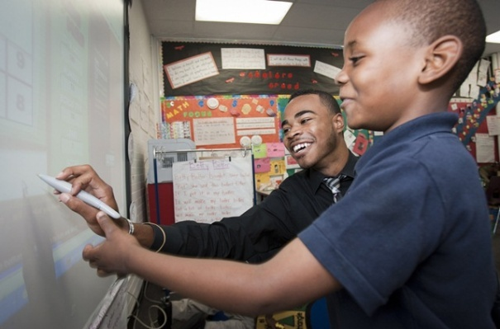
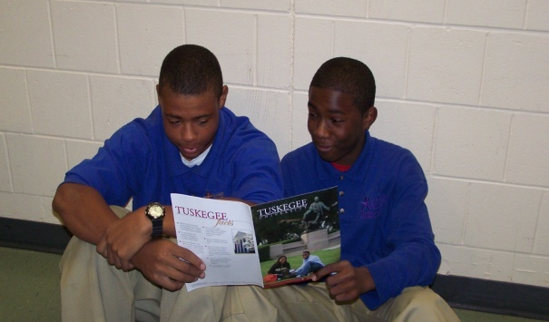

Positive Relationships
Adult
to
Adult
ALL adults model the behavior they wish to see in students
Mutual respect should guide this relationship
Student missteps as teachable moments
Same expectations for Student to Student interactions – Helps prevent bullying
Adult
to
Student
Student
to
Student

Slide 9
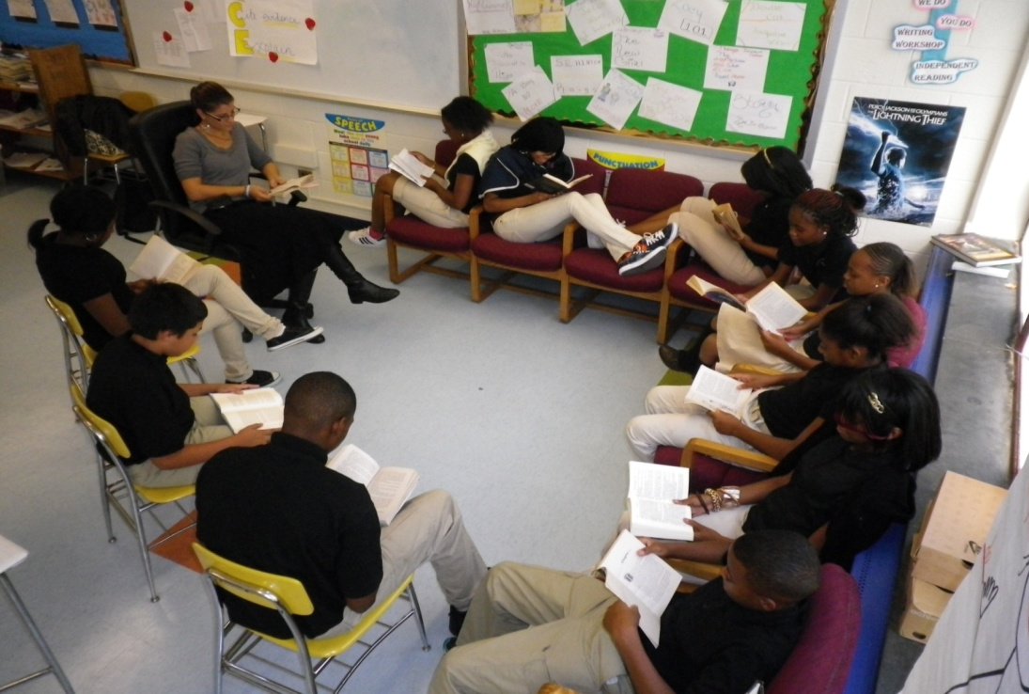
Engaging Classrooms
Feature student voice
Relevant lessons and materials
Reduction in student misbehaviors

Slide 10
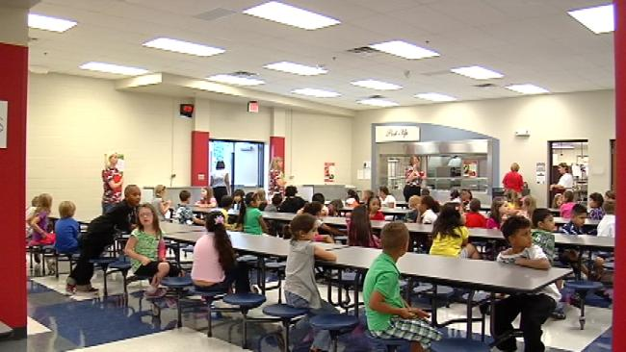
School Environment
Reflects degree to which students and staff are regarded
Clean, welcoming and attractive – at a minimum

Slide 11
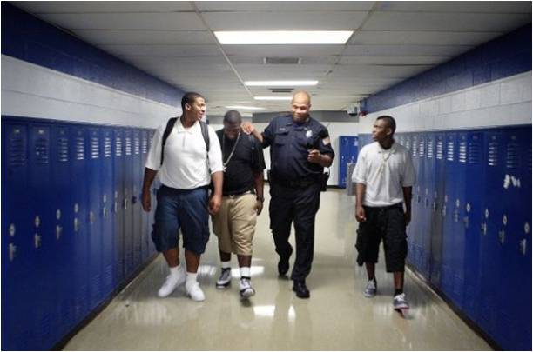
School Safety
Safety is physical and emotional
Security personnel - properly trained clearly defined roles
Invested in student success

Slide 12
Baltimore City Historical Suspension Data Source: Maryland State Department of Education Data Files
2004 | 2007 | 2012 | 2013 | 2014

Slide 13
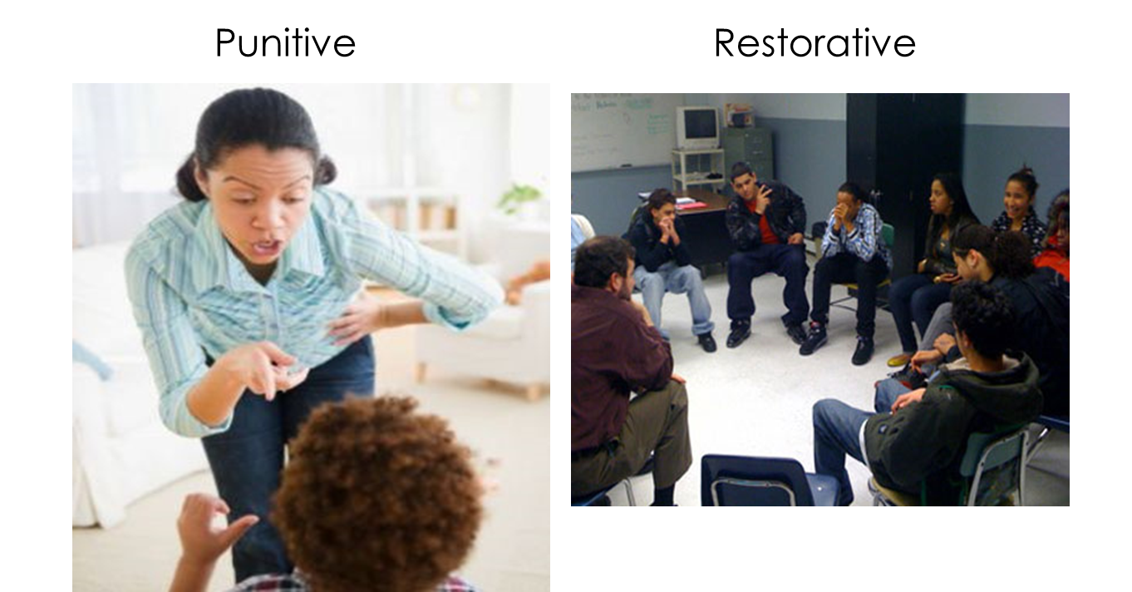
Shifting Mindsets to Create Positive School Climates

Slide 14
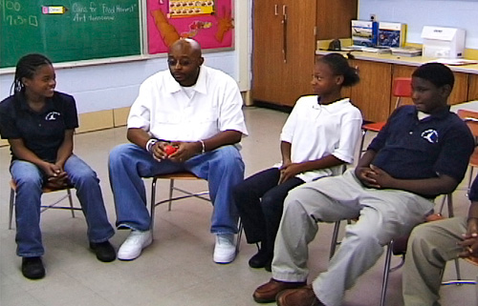
Restorative Solutions: Restorative Practices
Responsive
Accountable
ALL voices are heard
Wrongdoer listens to effects of actions
All agree on future acts, sanctions
All involved meet to restore the community

Slide 15
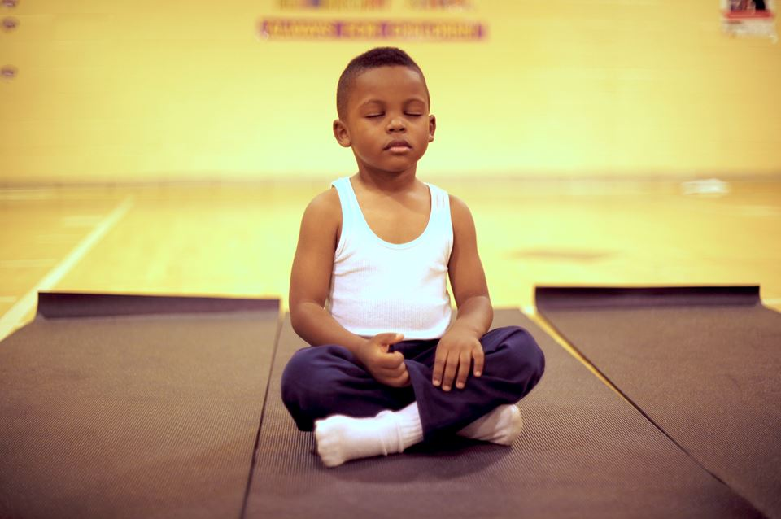
Restorative Solutions: Mindfulness

Slide 16
APPENDIX

Slide 17
Leveled Supports for Student Behaviors
FEW
Level III
Level II
Small Group or Individual
Example: Student and/or Parent Conferences
Level I
Whole School Interventions - establish a positive school climate
Example: Restorative Practices
Level III
Intensive Supports to deescalate, provide support for and address student crises
Example: Individual Counseling
SOME
ALL

Slide 18
Examples of Leveled Supports in
Baltimore City Schools
Restorative Practices
PBIS
Positive Behavioral Interventions and Support
Mental Health Referrals
Student Support Team Meetings
Mindfulness
Check and Connect
Community Conferencing
Peer Mediation
Peer Group Connections

Slide 19
Restorative Practices
RP can take various forms such as student conferences; peer mediation; and student court, but they aim to restore the community rather than to simply punish the wrongdoer.
RP focuses on repair of harm rather than harsh punishment of the student
RP creates individualized solutions to holds actor accountable and repair harm to victim
Uses student missteps as teachable moments for all parties

Slide 20
Mindfulness
Practice of teaching participants to focus thoughts in the present moment: deep breathing, relaxation, visualization are among techniques used
Can be used as a whole school practice or leveled support
Beneficial to all participants – students and staff
Easily compliments existing school wide practices
Research indicates: improved attention, emotion regulation, stress and depression reduction

Slide 21
Targeted Training for
School Climate Improvement
Cultural competency/implicit bias
Classroom Management
Youth Development
Childhood Trauma
Adult and student de-escalation practices
Conflict resolution and restorative questioning
Anti-bullying training and sensitivity – including protecting the rights of students with disabilities, and LGBTQ students

Slide 22
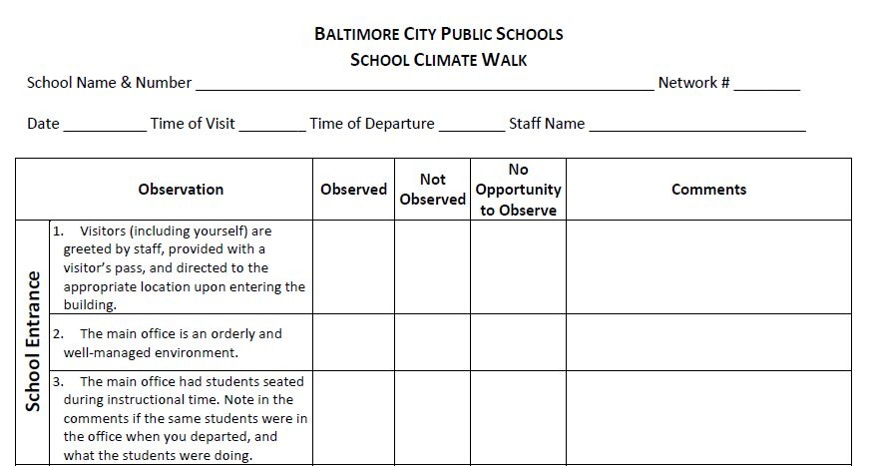
Tools: School Climate Walk
“The Climate Walk observation tool offers a unique, qualitative and timely appraisal of the overall functioning of a school on any given day and provide opportunities for regular collaboration between district staff and school leaders. This useful process should be pursued as often as is feasible.” (JHU Baltimore Education Research Consortium)
Twenty focus areas:
School Entrance
Physical Environment
Student/Staff Relationships
Transitions
Classrooms

Slide 23
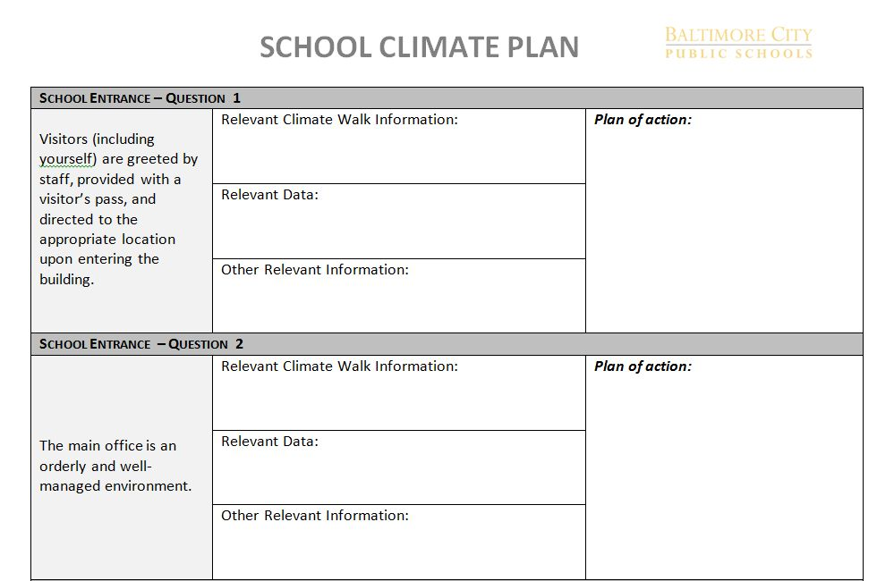
Tools: School Climate Plan
The School Climate Plan is a companion document to the School Climate Walk.
It is used to create an data driven plan for school climate improvement.

Slide 24
References
Cherry, R. (2015). Black Students Suffer from Stress at Home, Not lead Poisoning. National Review.
Durham, R. E., Bettencourt, A., & Connolly, F. (2014). Measuring School Climate: Using Existing Data Tools on Climate and Effectiveness to Inform School Organizational Health . Baltimore Research Education Consortium- Johns Hopkins University.
Jensen, E. (2013). How Poverty Affects Classroom Engagement. Faces of Poverty, 24-30.
Kwon, D. (2015). Poverty Disturbs Children's Brain Development and Academic Performance : Brain development predicts test scores in low-income children. Scientific American.
Maryland State Department of Education . (2014). The Maryland Guidelines for a State Code of Discipline .
Milam, A., Furr-Holden, C., & Leaf, P. (2010). Perceived School and Neighborhood Safety, Neighborhood Violence and Academic Achievement in Urban School Children. The Urban Review, 456-467.
Open Society Institute- Baltimore. (2014). Improving Conditions for Learning: Creating Pyramids of Behavioral Interventions2.
Payne, A. A., & Welch, K. (2013). Restorative Justice in Schools: The Influence of Race on Restorative Discipline. Youth & Society , 1-26.
Player, C., & Eaton, S. (2009). Things I Have Seen and Heard: How Educators, Youth Workers and Elected Officials Can Help Reduce the Damage of Childhood Exposure to Violence in Communities. Institute for Race and Justice- Harvard Law School.
Reeves, D. B. (2003). High Performance in High Poverty Schools: 90/90/90 and Beyond. Center for Performance Assessment.
Seaman, A. (2015). School-based mindfulness training may reduce stress, trauma. Reuters.
Shindler, J., Jones, A., Williams, A. D., Taylor, C., & Cadenas, H. (2009). Exploring Below the Surface: School Climate Assessment and Improvement as the Key to Bridging the Achievement Gap. Alliance for the Study of School Climate- CSU.
Silvernail, D. L., Sloan, J. E., Paul, C. R., Johnson, A. F., & Stump, E. K. (2014). The Relationship Between School Poverty and Student Achievement in Maine. Maine Education and Policy Research Institute- University of Southern Maine.
Sosnowski, J. (2011). Statistics on How Poverty Affects Children in Schools. Seattle PI Education .
Teaching, T. P. (1991). Haberman, M. Phi Delta Kappan , 290-294.

